Slide 1







CREDIT CARD DEFAULT PREDICTION & LOAN RECOMMENDATION
Presented by: Data squad

Slide 2






INTRODUCTION
Objective: Predict whether a customer will default on their credit card payment.
Dataset: Default of Credit Card Clients dataset (UCI Machine Learning Repository).
Models Used: Random Forest & Neural Network.
Additional Goal: Generate loan recommendations based on risk assessment.

Slide 3




DATASET OVERVIEW
SOURCE
UCI Machine Learning Repository
ABOUT THE DATASET
Contains: 30,000 customer records with financial history.
Features:
Demographic data (age, gender, etc.)
Credit history & payment behavior
Credit limits and bill amounts
Target Variable: "default" (1 = Default, 0 = No Default)

Slide 4
DATA PREPROCESSING
Removed target variable (“default”) from feature set.
Encoded categorical variables using Label Encoding.
Standardized numerical features using StandardScaler.
Addressed class imbalance using SMOTE (Synthetic Minority Over-sampling Technique).
Split data into training (80%) and testing (20%) sets.

Slide 5
MODEL 1 RANDOM FOREST CLASSIFIER
Ensemble learning method using multiple decision trees.
Parameters:
100 estimators (trees)
Random state = 42 for reproducibility
Predictions: Based on majority voting.
Accuracy - Random Forest Accuracy: 0.8636849989300235

Slide 6
MODEL 1 DEEP LEARNING NEURAL NETWORK
Multi-layer Perceptron (MLP) with:
512, 256, 128 neurons in hidden layers
ReLU activation function
Dropout layers for regularization
Adam optimizer
Training: 30 epochs, batch size = 64.
Accuracy - Neural Network Accuracy: 0.7495185136795044

Slide 7
CONFUSION MATRIX
Metric | No Default (0) | Default (1) | Remarks
Precision | 0.85 | 0.88 | 88% of predicted defaults were correct, but 15% of non-default predictions were wrong.
Recall | 0.89 | 0.84 | 89% of actual non-defaulters were correctly classified, but 16% of actual defaulters were missed.
F1-Score | 0.87 | 0.86 | Balanced trade-off between precision & recall for both classes.

Slide 8
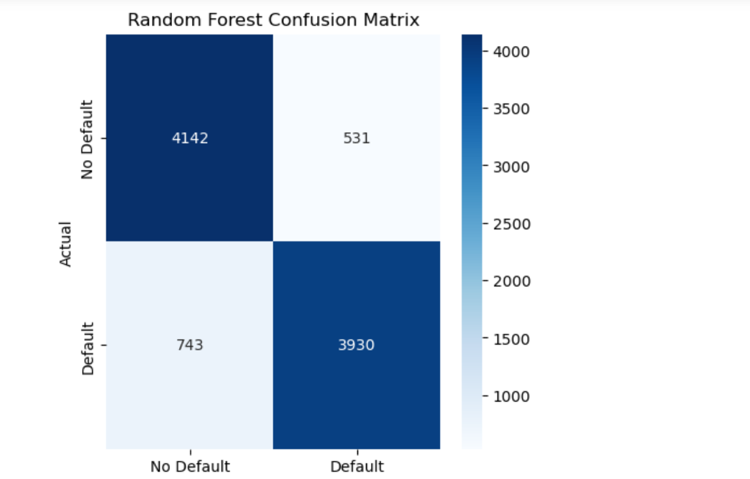
CONFUSION MATRIX

Slide 9
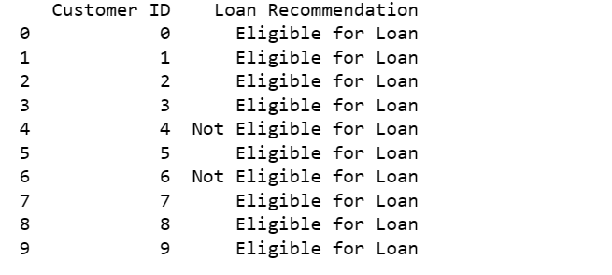
LOAN RECOMMENDATION

Slide 10
CONCLUSION
The Random Forest model performs well, correctly predicting 86.37% of credit card defaults and non-defaults in the test set
Ensemble learning methods like Random Forest work well with structured data, handling non-linearity and missing values efficiently.
The model likely benefited from its ability to capture complex relationships in the dataset.
Neural Network Accuracy: 74.95%
The Neural Network performed moderately well but was significantly lower than the Random Forest model. Deep learning models require larger datasets to generalize well, and may need additional hyperparameter tuning to improve performance.
The performance gap suggests that tabular financial data might be better suited for traditional machine learning models like Random Forest rather than deep learning approaches

